Slide 1
Tackling the Gaps & Islands Problem
With T-SQL Window Functions

Slide 2






















Thank you, partners 💖

Slide 3








Contact
Koen Verbeeck
@Ko_Ver
@koenv.bsky.social
SQLkover.com

Slide 4

Outline
01
What are window functions?
02
Common use cases
03
The gaps & islands problem
04
Solving the “latency” use case
05
Conclusion

Slide 5
What are window functions?

Slide 6
Window functions
window function
OVER (
[PARTITION BY expression]
[ORDER BY expression]
[ROWS | RANGE BETWEEN frame bound AND frame bound]
)

Slide 7

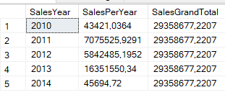
EXAMPLE 1
Available since SQL Server 2005
SELECT DISTINCT
SalesYear = YEAR(OrderDate)
,SalesPerYear = SUM(SalesAmount) OVER (PARTITION BY YEAR(OrderDate))
,SalesGrandTotal = SUM(SalesAmount) OVER ()
FROM AdventureWorksDW2019.dbo.FactInternetSales
ORDER BY SalesYear;

Slide 8
Logical query processing order
FROM
ON (used in joins)
OUTER/INNER/FULL/CROSS used in joins and/or APPLY
PIVOT/UNPIVOT
WHERE
GROUP BY
[CUBE / ROLLUP]
HAVING
SELECT
Calculating expressions
DISTINCT
ORDER BY
TOP / OFFSET-FETCH

Slide 9
EXAMPLE 2
SELECT
tmp.CustomerAlternateKey
,tmp.SalesAmount
,CustomerRank = RANK() OVER (ORDER BY tmp.SalesAmount DESC)
FROM
( -- first calculate the sales amount for each customer
SELECT
c.CustomerAlternateKey
,SalesAmount = SUM(f.SalesAmount)
FROM dbo.FactInternetSales f
JOIN dbo.DimCustomer c ON c.CustomerKey = f.CustomerKey
GROUP BY c.CustomerAlternateKey
) tmp;

Slide 10
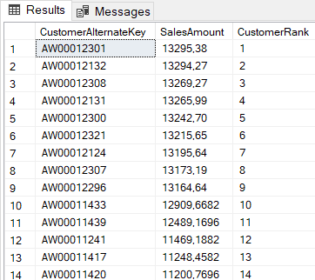
EXAMPLE 2
SELECT
tmp.CustomerAlternateKey
,tmp.SalesAmount
,CustomerRank = RANK() OVER (ORDER BY tmp.SalesAmount DESC)
FROM
( -- first calculate the sales amount for each customer
SELECT
c.CustomerAlternateKey
,SalesAmount = SUM(f.SalesAmount)
FROM dbo.FactInternetSales f
JOIN dbo.DimCustomer c ON c.CustomerKey = f.CustomerKey
GROUP BY c.CustomerAlternateKey
) tmp;

Slide 11

EXAMPLE 3
Since SQL Server 2012 - real window functions
WITH CTE_source AS ( SELECT YearMonth = YEAR(OrderDate) * 100 + MONTH(OrderDate) ,[Year] = YEAR(OrderDate) ,OrderQuantity = SUM(OrderQuantity) FROM dbo.FactResellerSales GROUP BY YEAR(OrderDate) * 100 + MONTH(OrderDate) ,YEAR(OrderDate) ) SELECT YearMonth ,OrderQuantity ,RunningTotal = SUM(OrderQuantity) OVER (PARTITION BY [Year] ORDER BY YearMonth ROWS BETWEEN UNBOUNDED PRECEDING AND CURRENT ROW ) FROM CTE_source ORDER BY YearMonth;

Slide 12
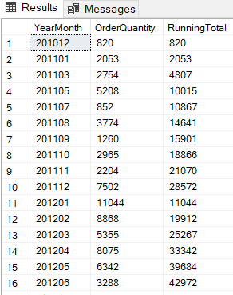
EXAMPLE 3
Since SQL Server 2012 - real window functions
WITH CTE_source AS ( SELECT YearMonth = YEAR(OrderDate) * 100 + MONTH(OrderDate) ,[Year] = YEAR(OrderDate) ,OrderQuantity = SUM(OrderQuantity) FROM dbo.FactResellerSales GROUP BY YEAR(OrderDate) * 100 + MONTH(OrderDate) ,YEAR(OrderDate) ) SELECT YearMonth ,OrderQuantity ,RunningTotal = SUM(OrderQuantity) OVER (PARTITION BY [Year] ORDER BY YearMonth ROWS BETWEEN UNBOUNDED PRECEDING AND CURRENT ROW ) FROM CTE_source ORDER BY YearMonth;

Slide 13
How does it work?
The PARTITION BY defines the windows, one for each year
The ORDER BY sorts the rows within the window. Here they’re sorted by month
The ROWS BETWEEN UNBOUNDED PRECEDING AND CURRENT ROW frame extent sum all previous rows and the current row
11044 + 8868 + 5355 = 25267

Slide 14
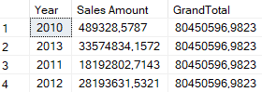
Wut?
SELECT
[Year] = YEAR(OrderDate)
,[Sales Amount] = SUM(SalesAmount)
,GrandTotal = SUM(SUM(SalesAmount)) OVER ()
FROM dbo.FactResellerSales
GROUP BY YEAR(OrderDate);

Slide 15
Common use cases

Slide 16
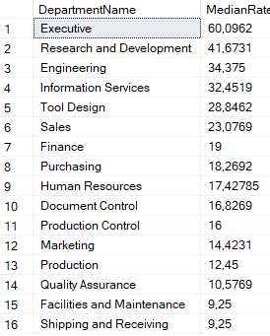
Median
SELECT DISTINCT
DepartmentName
,MedianRate = PERCENTILE_CONT(0.5)
WITHIN GROUP(ORDER BY BaseRate)
OVER (PARTITION BY DepartmentName)
FROM AdventureWorksDW2019.dbo.DimEmployee
ORDER BY MedianRate DESC;

Slide 17
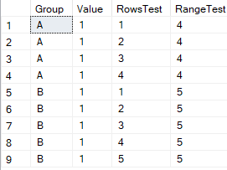
RANGE vs ROWS
SELECT
[Group]
,[Value]
,RowsTest = SUM([Value]) OVER (PARTITION BY [Group] ORDER BY [Value]
ROWS BETWEEN UNBOUNDED PRECEDING AND CURRENT ROW)
,RangeTest = SUM([Value]) OVER (PARTITION BY [Group] ORDER BY [Value]
RANGE BETWEEN UNBOUNDED PRECEDING AND CURRENT ROW)
FROM Test.dbo.TestRangeRows;

Slide 18
Dealing with duplicates
WITH cte_src AS ( SELECT ID ,EmployeeKey ,EmployeeName ,InsertDate ,RID = ROW_NUMBER() OVER (PARTITION BY EmployeeKey ORDER BY InsertDate) FROM Test.dbo.EmployeeDuplicate ) DELETE FROM Test.dbo.EmployeeDuplicate FROM Test.dbo.EmployeeDuplicate ed JOIN cte_src c ON ed.ID = c.ID WHERE c.RID <> 1;

Slide 19
Dealing with duplicates
WITH cte_src AS ( SELECT ID ,EmployeeKey ,EmployeeName ,InsertDate ,RID = ROW_NUMBER() OVER (PARTITION BY EmployeeKey ORDER BY InsertDate) FROM Test.dbo.EmployeeDuplicate ) DELETE FROM Test.dbo.EmployeeDuplicate FROM Test.dbo.EmployeeDuplicate ed JOIN cte_src c ON ed.ID = c.ID WHERE c.RID <> 1;

Slide 20
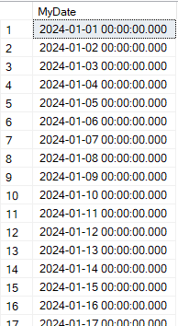
Tally table
WITH T0 AS (SELECT N FROM (VALUES (1),(1)) AS tmp(N))
,T1 AS (SELECT N = 1 FROM T0 AS a CROSS JOIN T0 AS b)
,T2 AS (SELECT N = 1 FROM T1 AS a CROSS JOIN T1 AS b)
,T3 AS (SELECT N = 1 FROM T2 AS a CROSS JOIN T2 AS b)
,T4 AS (SELECT N = 1 FROM T3 AS a CROSS JOIN T3 AS b)
SELECT DATEADD(DAY,ROW_NUMBER() OVER (ORDER BY (SELECT NULL)) -1,’2024-01-01')
FROM T4;
this will quickly generate 65K rows use it to replace loops with set-based logic

Slide 21
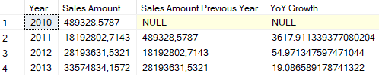
Inspect other rows
WITH CTE_PY AS ( SELECT [Year] = YEAR(OrderDate) ,[Sales Amount] = SUM(SalesAmount) ,[Sales Amount PY] = LAG(SUM(SalesAmount)) OVER (ORDER BY YEAR(OrderDate)) FROM AdventureWorksDW2019.dbo.FactResellerSales GROUP BY YEAR(OrderDate) ) SELECT [Year] ,[Sales Amount] ,[Sales Amount Previous Year] ,[YoY Growth] = 100.0 * ([Sales Amount] - [Sales Amount Previous Year]) / [Sales Amount Previous Year] FROM CTE_PY ORDER BY [Year];

Slide 22
Inspect other rows
WITH CTE_PY AS ( SELECT [Year] = YEAR(OrderDate) ,[Sales Amount] = SUM(SalesAmount) ,[Sales Amount PY] = LAG(SUM(SalesAmount)) OVER (ORDER BY YEAR(OrderDate)) FROM AdventureWorksDW2019.dbo.FactResellerSales GROUP BY YEAR(OrderDate) ) SELECT [Year] ,[Sales Amount] ,[Sales Amount Previous Year] ,[YoY Growth] = 100.0 * ([Sales Amount] - [Sales Amount Previous Year]) / [Sales Amount Previous Year] FROM CTE_PY ORDER BY [Year];

Slide 23
The gaps & islands problem

Slide 24
Gaps & islands problem
Common analytics problem
island
island
island
island
island
time
gap
gap
gap
gap
gap

Slide 25
Gaps & islands problem
Gaps = holes in the sequence
how many times did a server go offline, and for how long?
when did a student not attend class?
when was a consultant not on a project?
Islands = ranges of consecutive values
how long was someone visiting a website, and did they return?
was an employee sick for longer than a day? Did the sick period surpass a certain limit, so they’re now on extended sick leave?
how long was a consultant allocated to a project?

Slide 26
Gaps example
ID | ServerName | DayOnline
1 | MyServer | 01/05/2024
2 | MyServer | 02/05/2024
3 | MyServer | 03/05/2024
4 | MyServer | 04/05/2024
5 | MyServer | 05/05/2024
6 | MyServer | 07/05/2024
7 | MyServer | 08/05/2024
8 | MyServer | 09/05/2024
9 | MyServer | 15/05/2024
10 | MyServer | 16/05/2024
11 | MyServer | 17/05/2024
12 | MyServer | 19/05/2024
13 | MyServer | 20/05/2024
ServerName | DayOffline
MyServer | 06/05/2024
MyServer | 10/05/2024
MyServer | 11/05/2024
MyServer | 12/05/2024
MyServer | 13/05/2024
MyServer | 14/05/2024
MyServer | 18/05/2024
ServerName | DaysOffline
MyServer | 1
MyServer | 5
MyServer | 1

Slide 27
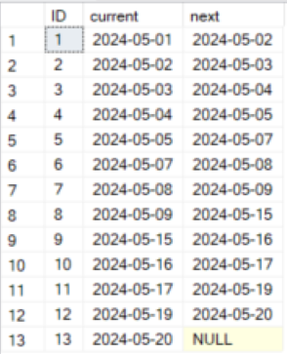
Find the next start date
SELECT ID ,[current] = DayOnline ,[next] = LEAD(DayOnline) OVER (ORDER BY DayOnline) FROM dbo.[Server];

Slide 28
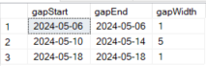
Find gaps > 1
same as previous slide
WITH cte_lead AS ( SELECT [current] = DayOnline ,[next] = LEAD(DayOnline) OVER (ORDER BY DayOnline) FROM dbo.[Server] ) SELECT gapStart = DATEADD(DAY, 1, [current]) ,gapEnd = DATEADD(DAY,-1, [next]) ,gapWidth = DATEDIFF(DAY, [current], DATEADD(DAY,-1, [next])) FROM cte_lead WHERE DATEDIFF(DAY, [current], [next]) > 1;
identify the gaps

Slide 29
Islands example
ID | ServerName | DayOnline
1 | MyServer | 01/05/2024
2 | MyServer | 02/05/2024
3 | MyServer | 03/05/2024
4 | MyServer | 04/05/2024
5 | MyServer | 05/05/2024
6 | MyServer | 07/05/2024
7 | MyServer | 08/05/2024
8 | MyServer | 09/05/2024
9 | MyServer | 15/05/2024
10 | MyServer | 16/05/2024
11 | MyServer | 17/05/2024
12 | MyServer | 19/05/2024
13 | MyServer | 20/05/2024
ServerName | StartDate | EndDate
MyServer | 01/05/2024 | 05/05/2024
MyServer | 07/05/2024 | 09/05/2024
MyServer | 15/05/2024 | 17/05/2024
MyServer | 19/05/2024 | 20/05/2024

Slide 30
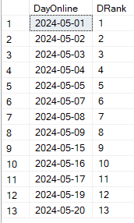
Calculate dense rank
SELECT
DayOnline
,DRank = DENSE_RANK() OVER (PARTITION BY ServerName ORDER BY DayOnline)
FROM dbo.[Server];
Dense rank = rank with no gaps, ties have the same rank

Slide 31
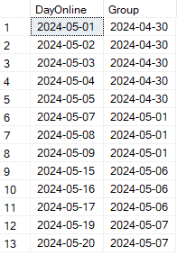
Subtract rank from date
SELECT DayOnline
,[Group] = DATEADD(DAY,-1 * DENSE_RANK() OVER
(PARTITION BY ServerName ORDER BY DayOnline) , DayOnline) FROM dbo.[Server];

Slide 32
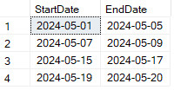
Aggregate
WITH cte_groups AS ( SELECT
DayOnline
,[Group] = DATEADD(DAY, -1 * DENSE_RANK() OVER (PARTITION BY ServerName ORDER BY DayOnline) , DayOnline) FROM dbo.[Server] ) SELECT StartDate = MIN(DayOnline) ,EndDate = MAX(DayOnline) FROM cte_groups GROUP BY [Group];
same as previous slide
aggregate to get range

Slide 33
Calculating “latency” of a consultant

Slide 34
What is latency?
Duration in days between
their start date and their first project
or the end date of a project and the next project
“bench time”
We don’t live in an ideal world where a consultant only does one project at a time
“Significant allocation”
at least 60% allocated (of their work schedule)
for at least 15 workdays
parameterizable
Also interested in “zero-latency”
consultant goes directly from one project to another

Slide 35
Data sources
Date table with working day indicator
Headcount table
which employees are working on which days
against which regime?
Allocations table
start and end date of a project
#days per week allocated
HR table
indicates the start date of new employees

Slide 36
Significant allocations
island >= 60%
island < 15 WD
time
gap = < 60%
time

Slide 37
Starter latency
first significant allocation
start date
time
starter latency = duration in WD between start date and start of allocation

Slide 38
Bench latency
time
time
ignore if
already calculated in starter latency
data is incomplete as it may result in incorrect latency

Slide 39
Zero latency aka good job!
island
island
time
island
island
island
island
time
island
island
the droid date we’re looking for
time

Slide 40
DEMO
Notes:
show query history and get_ddl()

Slide 41
Conclusion

Slide 42

window functions are awesome
They can solve a wide range of common business analyses problems
gaps&islands is quite common, but is easy to solve with window functions
Code is more elegant and efficient
They have good performance out-of-the-box
be aware of the defaults

Slide 43


Resources
Window Functions Tutorial
T-SQL OVER clause
Logical Query Processing
Number series generator challenge solutions
Row Pattern Recognition in Snowflake
Previous NON NULL value

Slide 44

www.ae.be inspire@ae.be +32 16 39 30 60
Interleuvenlaan 27b
3001 Heverlee

Slide 45
Session Feedback💖
https://bit.ly/dMC2024_SessionFeedback

